Slide 1
Database Application Development
DBS201
Lecture 06

Slide 2
Application Architecture and Design
Web Services: Concepts, Architectures and Applications By Gustavo Alonso, Fabio Casati, Harumi Kuno, Vijay Machiraju. Chapter 1

Slide 3
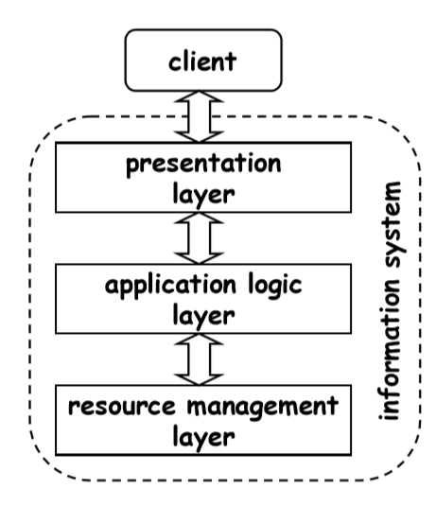
Application Layers
Applications are typically broken into three layers:
Presentation and user interface
Business (application) logic
Data access (resource management)

Slide 4
Presentation Layer
The presentation or the user interface provides the user interaction.
Different form of the presentation layers could be
Web browsers
Mobile phone user interface

Slide 5
Business Layer
The business or application logic layer provide the high level view and access of data.
In this layer, business rules are enforced.

Slide 6
Data Access Layer
The data access later is the interface between business layer and data resources. It deals with data storage and retrieval to support the business layer.

Slide 7
Application Design
Top-down Design
Bottom-up Design

Slide 8
Top-down Design
The functionality of the system is defined from the client’s point of view.
It determines how client interact with the system.
It focuses on high-level requirements.
Advantages:
It focuses on final goals.
It addresses
Functional issues – the operations that are supported
Non-functional issues – the performance and availability
Disadvantages
The system has to be entirely developed from scratch.

Slide 9
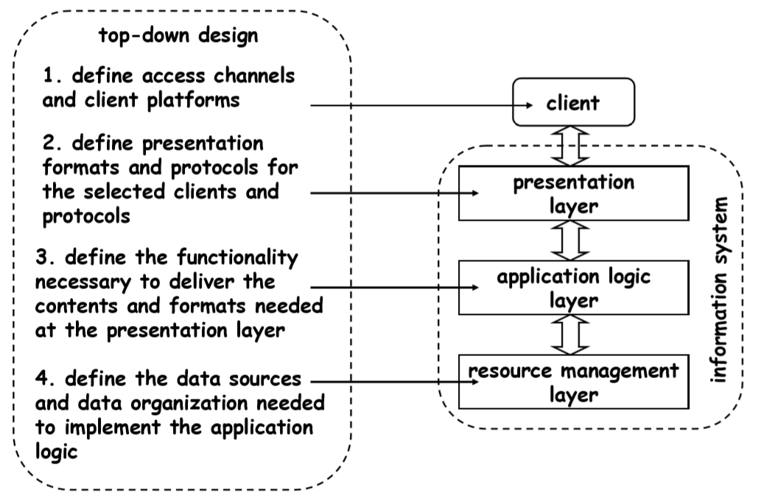
Top-down Design

Slide 10
Bottom-up Design
The system components and parts are designed.
The smaller parts and components of the system are then combined to achieve a higher goal.
New systems can be created by integrating existing systems.
The bottom-up approach includes:
Investigating existing applications and processes
Analyzing the problem domains
Redefining and reconstructing the problems
Determining the high-level objectives achieved by integrating these applications

Slide 11
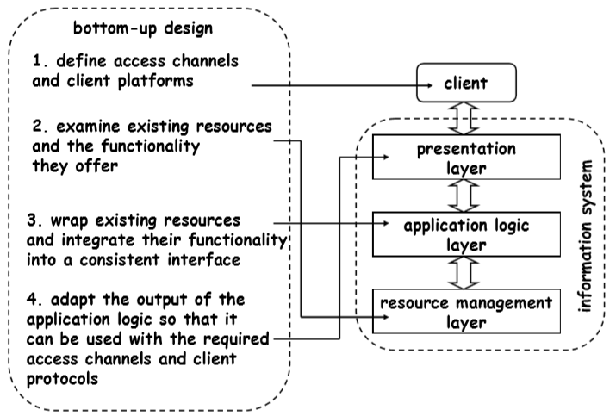
Bottom-up Design

Slide 12
Application Architecture
Two-tier architecture
Three-tier architecture

Slide 13
2 Tiered Architecture
The two-tier application is based on client server approch.
There is a direct communication between client and server.
Client request data from server. Further data processing can be done on the client side.
The two-tier architecture has two main parts:
Database
Client application
Advantages:
Since there is not any intermediate layer between client and server, two-tier application runs faster. Business and data managements are in one layer.
Disadvantages:
It supports limited number of clients.
The server cannot respond multiple request same time

Slide 14
3 Tiered Architecture
In this architecture, there is an intermediate layer between presentation (user interface) and data layers.
Three separate layers:
Presentation
In this layer, the users send requests and receive data.
Business/application logic
In this layer, business rules are applied on
data calculation
data validation
data input
Data
This layer includes methods to
connect to the data resource (database)
manipulate data such as insertion, deletion, and modification

Slide 15
Database Application Development
A First Course in Database Systems_3rd Edition
https://dev.mysql.com/doc/connector-cpp/8.0/en/Oracle document
MySQL Document

Slide 16
Three Tiered Architecture
It has three interactive parts:
Web Server
includes components that connect clients to the database systems.
Application Server
performs the business logic.
Database Server
This component runs the database and performs the queries requested from the application server.

Slide 17
Database Application
How SQL fits into a programming environment?
How a typical application can access a database to fetch or manipulate data in a database?
How to embed SQL to programs with programming languages such as C++?

Slide 18
Database Access from Application
How SQL commands can be executed in a host language?
Embedded SQL
Cursors
Dynamic SQL

Slide 19
Embedded SQL
SQL statements and commands can be used in the host language. In this course, we use C++ as the host language.
In an Embedded SQL approach, the host language can consist of either static or dynamic SQL or a combination of both.
One approaches to embed SQL statements in a host language:
Call Level Interface (CLI):
In this approach, a program uses some libraries to access the database. All SQL statements are set of strings that are passed to the database using a CLI function call.

Slide 20
SQL Application
Connect to DBMS
Retrieve data from the database
Manipulate data
Modify data in the database

Slide 21
MySQL Connector/C++
We use MySQL Connector/C++ 8.0 in this course, which provides C++ and plain C interfaces for communicating with MySQL servers.
It specifies how to use Connector/C++ to develop database applications.

Slide 22
MSQL/C++ Application
MySQL Documentation

Slide 23
Connecting to MySQL
First, a connection to MySQL server must be established.
MYSQL *mysql_real_connect(MYSQL *mysql, const char *host, const char *user, const char *passwd, const char *db, unsigned int port, const char *unix_socket, unsigned long client_flag)
MYSQL* conn; conn = mysql_real_connect(conn, “server", “username", “password", “database", 3306, nullptr, 0);
Free the connection conn whenever you do not need it.
delete conn;

Slide 24
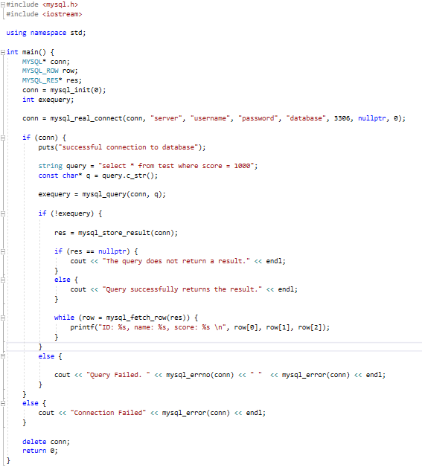
Running a Simple Query

Slide 25
mysql_query()
int mysql_query(MYSQL *mysql, const char *stmt_str)
First argument is the connection.
Second one is the statement to be excuted.
Description
mysql_query executes a SQL statement pointed to by the null-terminated string.
If a statement contains binary data such as ‘\0’, use mysql_real_query().
Return Values
It returns
Zero for successful execution
Nonzero if an error occurred

Slide 26
mysql_store_result()
MYSQL_RES *mysql_store_result(MYSQL *mysql)
Description
You call this function after executing mysql_query() or mysql_real_query() for a successful query execution.
Call function mysql_free_result() after you are done with the result set.
Allocates a MYSQL_RES structure to store the result of the query.
MYSQL_RES* res;
If there are no rows returned, the result set will be empty.
Return Values
A pointer to a MYSQL_RES result structure including the results.
If an error occurred or NULL if the query returns no result.
To find out if there is an error or the query has not returned a result, execute one of the followings:
mysql_error() returns a nonempty string
mysql_errno() returns nonzero
mysql_field_count() returns zero

Slide 27
mysql_error()
const char *mysql_error(MYSQL *mysql)
Description
mysql_error() returns a null-terminated string as the error message.
This function returns the error for the most recent function call.
Return values
A string (a null-terminated character string) with the error message.
An empty string if no error occurred.

Slide 28
mysql_errno()
unsigned int mysql_errno(MYSQL *mysql)
Description
mysql_errno() returns the error code for the most recent function call.
Return values
A none zero value as the error code, there is any error.
Or zero if there no error.

Slide 29
mysql_fetch_row()
MYSQL_ROW mysql_fetch_row(MYSQL_RES *result)
MYSQL_ROW row; //stores a row
MYSQL_RES* res; //stores a result set
row = mysql_fetch_row(res);
Description
mysql_fetch_row() retrieves the next row of a result set.
Return values
returns NULL if there are no more rows to retrieve.
returns an error. Check whether mysql_error() returns a nonempty string or mysql_errno() returns nonzero.

